Slide 1
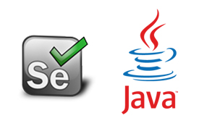
Automation Testing
By- Manas

Slide 2

SELENIUM
Selenium is the functional and regression testing tool which is used to automate functional and Regression Test case scenarios.
Selenium is one of the most widely used open-source Web UI (User Interface) automation testing tool. That supports automation across different browsers, platforms and programming languages.

Slide 3
SELENIUM
The original name of the Selenium was JSFT(Java Script Functional Tester). Later stages they changed name to Selenium and released into market.
Selenium supports multiple languages like Java, c#, PHP, Ruby, Python, Perl scripting etc. That means we can give instructions to selenium to perform testing on the application in any of the above languages.

Slide 4
Who developed Selenium?
Selenium was created by Jason Huggins in 2004. An engineer at ThoughtWorks, he was working on a web application that required frequent testing. Having realized that the repetitious Manual Testing of their application was becoming more and more inefficient, he created a JavaScript program that would automatically control the browser’s actions. He named this program as the “JavaScriptTestRunner.”

Slide 5
Advantages of Selenium
1. Selenium is the open source tool. That means we need not to pay any amount to start using selenium for testing.
2. Selenium supports multiple browsers like IE, firefox, opera, chrome, safari etc. That means we can able to test any application which has opened in any browser.
3. It supports multiple environments/platforms like windows, linux, mac etc. That means we can able to test any application which has opened in any environment.

Slide 6
Advantages of Selenium
4. It supports multiple languages like Java, c#, PHP, Python, Ruby, Perl etc. So that by knowing at least one language we can able to work on selenium.
5. It supports the built-in frameworks called Junit & TestNg.
6. Parallel test script execution is possible in selenium with the help of Grid

Slide 7
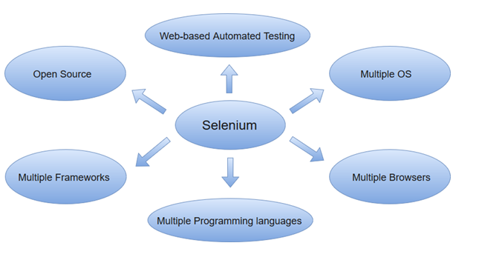

Slide 8
Disadvantages of Selenium
1. It supports only web based applications.
2. It supports multiple languages, so that we should have more technical knowledge.
3. Lack of technical support.
4. Selenium is the combination of multiple components, so that configuration and utilization of selenium is bit difficult comparatively with other tools.

Slide 9
Selenium Vs QTP
Features | Selenium | HP QTP
License | Open source tool | Required
Customer support | Selenium community forums | Dedicated HP support
Test Support | Supports automation only for web-based applications. | Support tests on both web and desktop-based applications.
Resource consumption during test scripts execution | Low resource consumption | High resource consumption
Supported programming languages | Java, C#, Ruby, Python, Perl, PHP and JavaScript | VB Script.
Supported Environments | Android, iOS, Windows, Linux, Mac, Solaris. | Only for Windows
Supported Browsers | Google Chrome, Mozilla Firefox, Internet Explorer, Edge, Opera, Safari, etc. | Specific versions of Google Chrome, Mozilla Firefox and Internet Explorer.

Slide 10
SELENIUM COMPONENTS
Selenium comprises of four major components which include:
1. Selenium IDE (Integrated Development Environment)
2. Selenium RC (Remote Control)
3. Selenium WD (WebDriver)
4. Selenium Grid

Slide 11
Selenium Integrated Development Environment (IDE)
Selenium IDE is implemented as Firefox extension which provides record and playback functionality on test scripts. It allows testers to export recorded scripts in many languages like HTML, Java, Ruby, RSpec, Python, C#, JUnit and TestNG. You can use these exported script in Selenium RC or Webdriver.
Selenium IDE has limited scope and the generated test scripts are not very robust and portable.

Slide 12
Selenium Remote Control
Selenium RC (officially deprecated by selenium) allows testers to write automated web application UI test in any of the supported programming languages.
It also involves an HTTP proxy server which enables the browser to believe that the web application being tested comes from the domain provided by proxy server.

Slide 13
SELENIUM WEBDRIVER
Web driver is the advanced for selenium RC which we can use to design the test scripts and execute the test scripts in different browsers and in the different environments.
Selenium WebDriver performs much faster as compared to Selenium RC because it makes direct calls to the web browsers. RC on the other hand needs an RC server to interact with the web browser.

Slide 14
Advantages of Webdriver
1. Like as RC we need not to start the server for web driver.
2. We can access RC commands into web driver but we cannot access web driver commands into RC.
3. Default synchronization is applicable for page loadings in webdriver.
4. We can handle multiple similar elements (links, buttons, images etc) in selenium webdriver.
5. We can handle alert messages popup windows using web driver.
6. We can handle mouse over operations (mouse movements) keyboard operations in web driver.
7. We can handle web tables using webdriver.
8. We can handle multiple windows (more than one window using web driver)

Slide 15
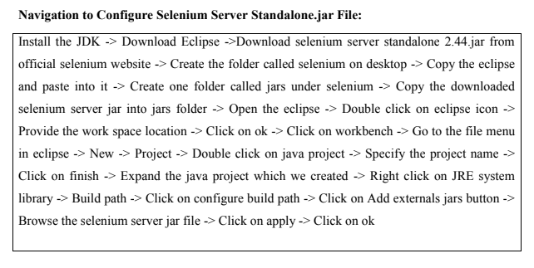
For working with selenium webdriver we need to configure selenium standalone server with eclipse.

Slide 16
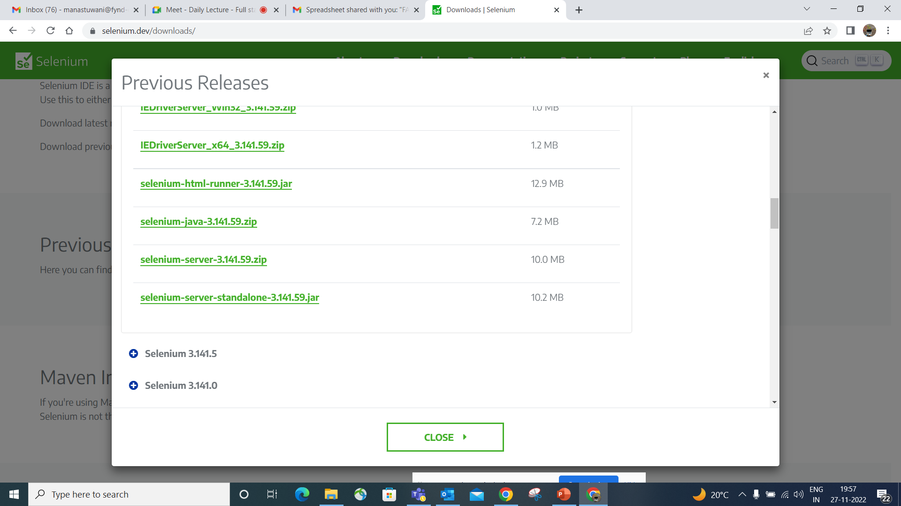

Slide 17
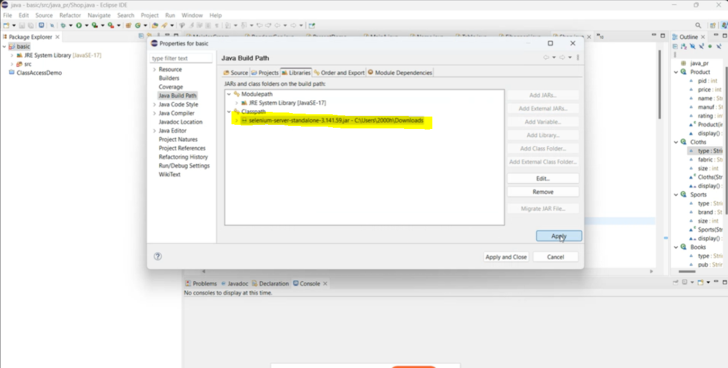
Selenium Configuration with Java Project Right Click on the Project -> Build Path -> Configure Build Path -> Select class path in Libraries tab -> Add External Jar -_ Select Selenium Jar file -> Apply and Close

